Slide 1

Evidence of Evolution

Slide 2
10.1 Early Ideas About Evolution
After this section you will be able to……
Explain what species is an the mechanisms of evolution
Describe the theory of geological change

Slide 3
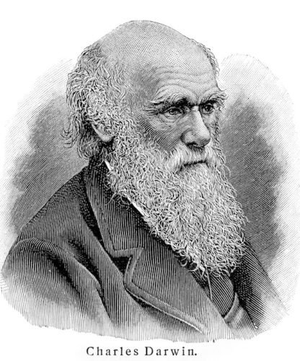
Early Ideas About Evolution
There were theories of biological and geologic change before Darwin.
Evolution is the process of biological change by which descendants come to differ from their ancestors.
Most of today’s understanding of evolution is based on Darwin’s work in the 1800’s, but he did not come up with the idea.

Slide 4
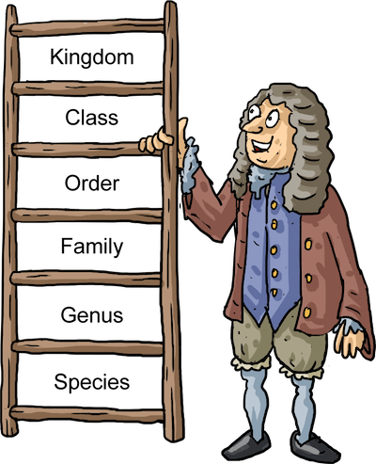
Species
A species is a group of organisms that can reproduce and have fertile offspring. The system was created in the 1700’s by a botanist named Carolus Linnaeus.
Linnaeus grouped organisms by physical similarities. This system shows evolutionary relationships and is still in use today.
During his time, it was believed that organisms on Earth did not change, but he proposed the opposite.

Slide 5
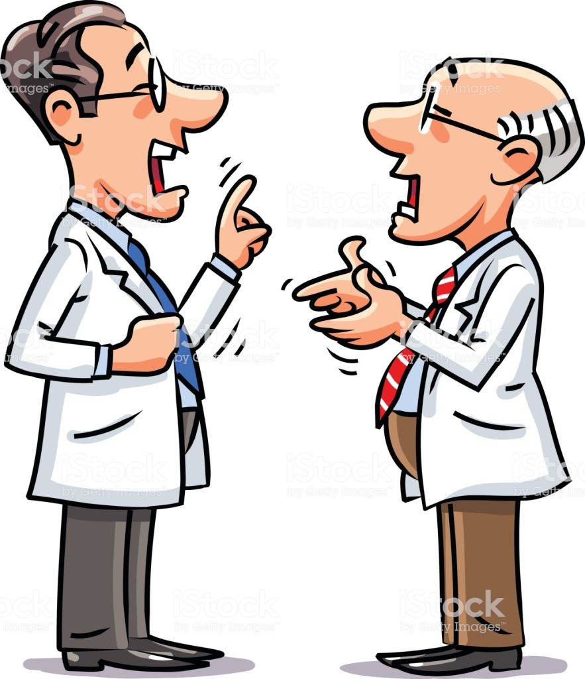
Mechanisms of Evolution
There were many ideas from multiple scientists in the 1700’s that described how species could change.
They can change
They can’t change
Environment affects evolution
Environment doesn’t affect evolution
The Earth is 6000 years old
The Earth is older than 6000 years

Slide 6
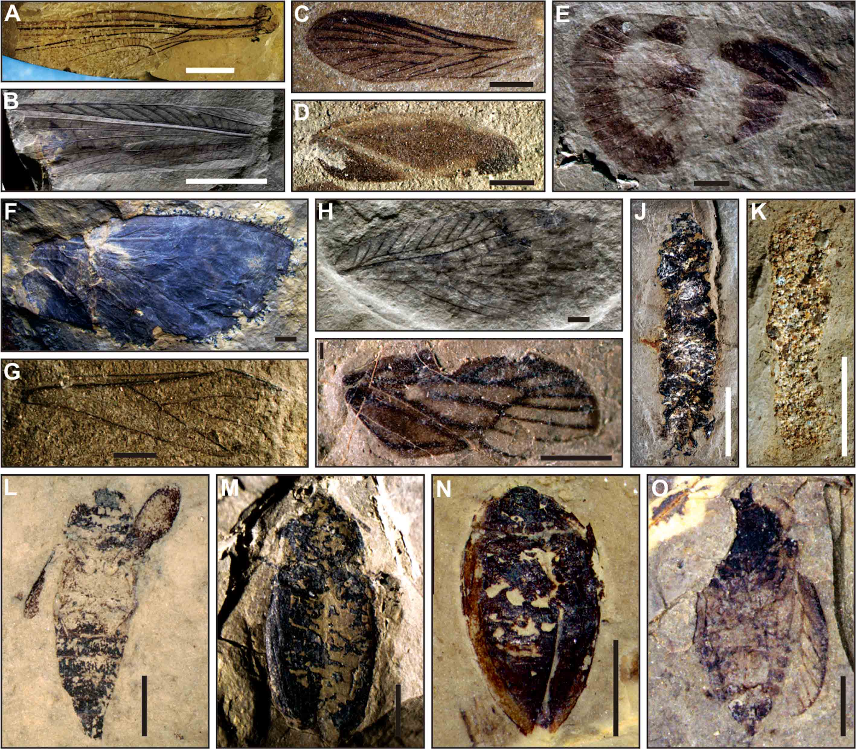
Theories of Geological Change
Some scientists concluded that species do go extinct once they started studying fossils. Fossils are traces of organisms that existed in the past.
The location of fossils in different rock layers provide clues about Earth’s past, but different ideas came from different geologists.

Slide 7
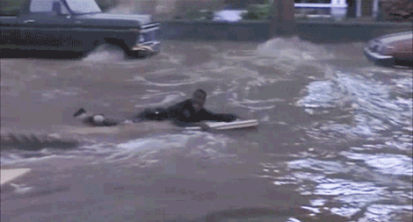
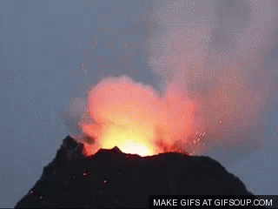
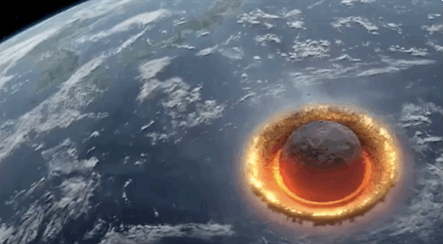
Theories of Geological Change
Catastrophism is the idea that past natural disasters, such as floods and volcanic eruptions, shaped landforms and caused species to become extinct in the process.

Slide 8
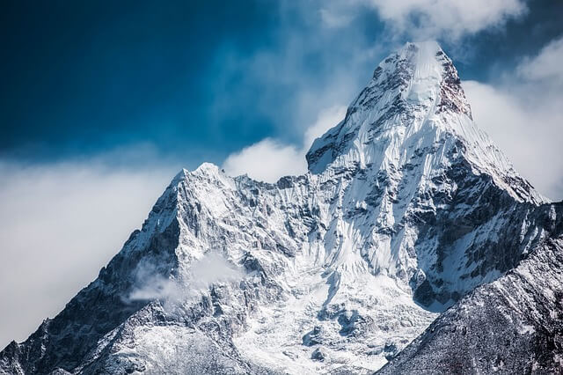
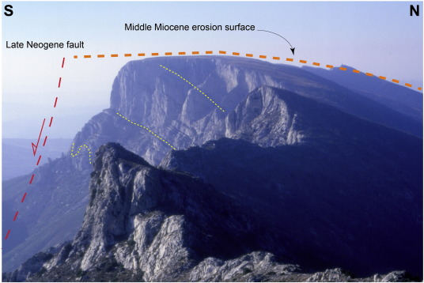
Theories of Geological Change
Gradualism is the idea that landforms were shaped by very slow changes over a long period of time, and not by natural disasters.

Slide 9
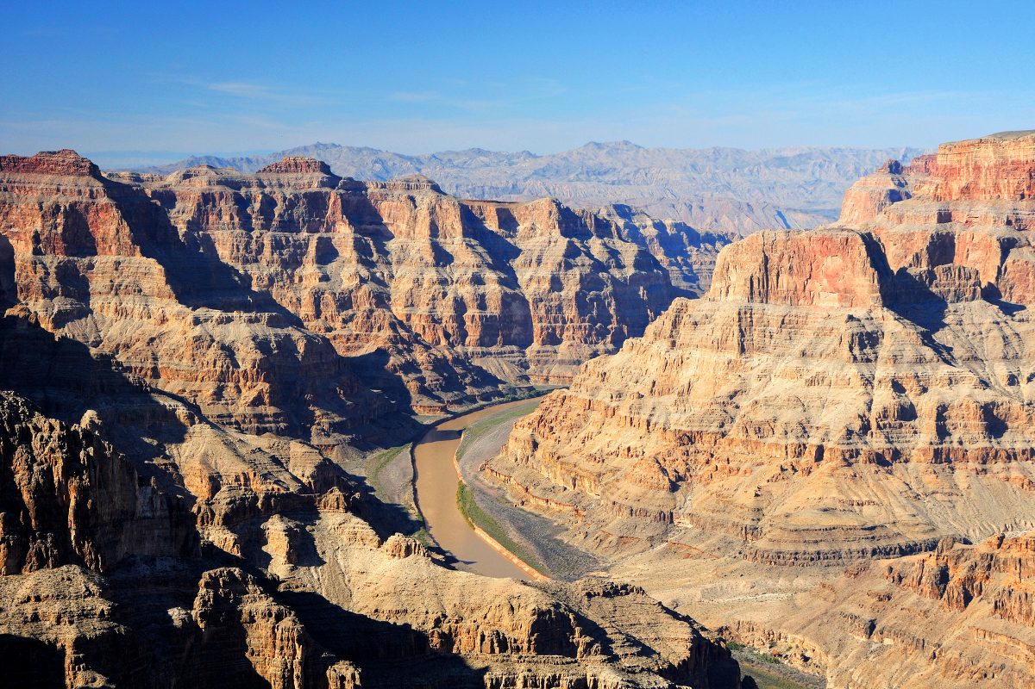
Theories of Geological Change
Uniformitarianism is the idea that the same processes that shaped landforms in the past also shape landforms today. In other words, the geologic processes that shape Earth are uniform, or the same, through time. Uniformitarianism became the favored theory of geologic change and played an important role in the development of Darwin’s theory.

Slide 10
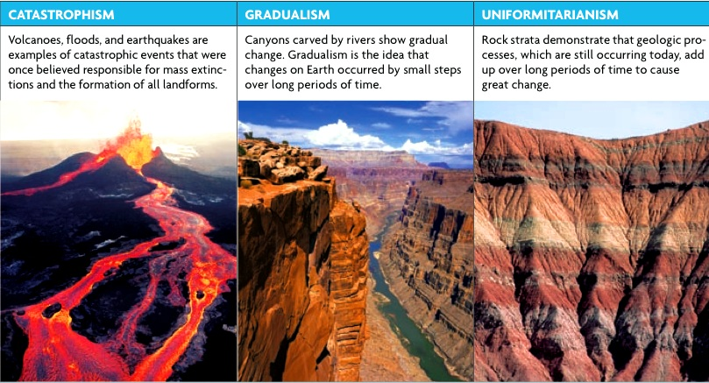

Slide 11
10.2 Darwin’s Observations
After this section you will be able to……
Explain Darwin’s observations among island species
Explain Darwin’s observations among fossil and geological evidence

Slide 12
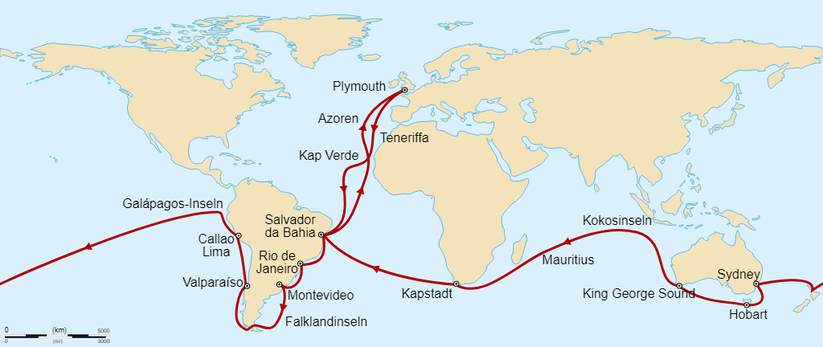
Species Observations
Charles Darwin sailed the coast of South America and the Pacific islands and spent over 20 years researching biological evolution. Darwin was amazed at the variation (differences in physical traits among individuals in a group of organisms) that he observed in his travels.

Slide 13
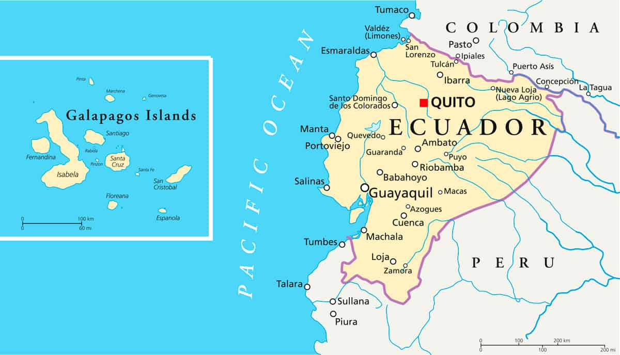
Species Observations
Darwin noticed that each island had a different variation of species, especially in the Galapagos Islands. He noticed that finches had different kinds of beaks, depending on the island and the food source available.
The differences seemed to match the environment and the diet of the finches. Darwin realized that species somehow adapt to their surroundings. An adaptation is a feature that allows an organism to better survive in its environment.

Slide 14
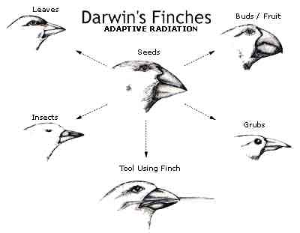

Slide 15
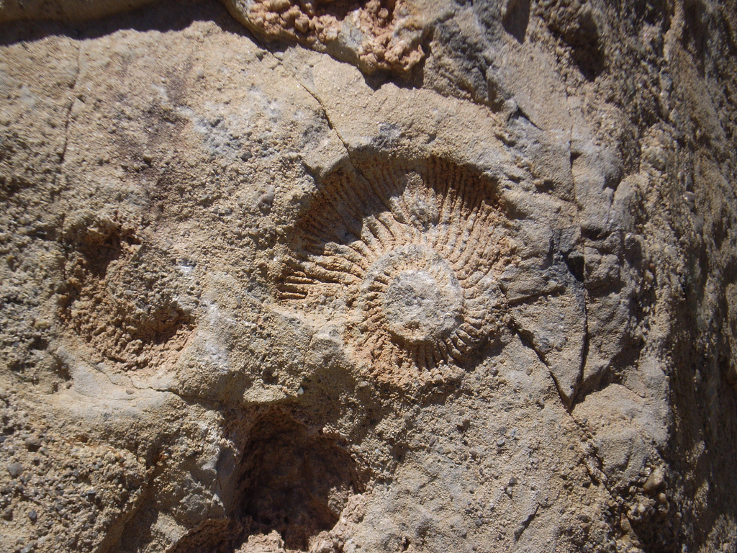
Fossil and Geological Evidence
Darwin noticed that some fossils looked similar to living species, suggesting that the living species might have a relationship with the fossil forms. This led Darwin to reason that the Earth must have been greater than 6000 years old.
Darwin also found fossil shells of marine organisms high up the Andes mountains! When he experienced an Earthquake, he noticed that land that had been underwater shifted above sea level.

Slide 16
10.4 Evidence of Evolution
After this section you will be able to……
Identify different sources that provide evidence to evolution
Compare and contrast homologous and analogous structures
Explain what vestigial structures are and how they provide clues to the history of species

Slide 17
Non-Darwin Sources
During Darwin’s time we did not understand genetic inheritance. Darwin used other sources to help support his ideas.
Fossils
Geography
Embryology
Anatomy

Slide 18
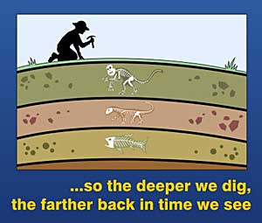
Fossils
Scientists before Darwin knew that organisms changed over time. Those who studied fossils noticed that different layers of rocks contained different organisms. The bottom layers of the rock are the oldest while the upper layers contain the most recent organisms.

Slide 19
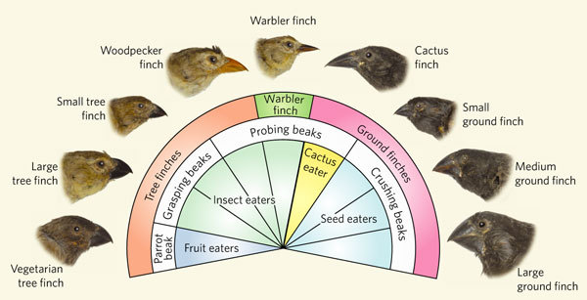
Geography
Darwin noticed that plants and animals present on each island looked similar, but not exactly the same. He hypothesized that organisms from the mainland had migrated to the islands.
Different islands had different food sources, climates, and predators. These various environmental conditions favored different traits in these migrant organisms.
Biogeography is the study of the distribution of organisms around the world.

Slide 20
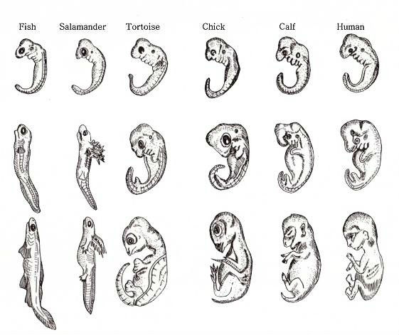
Developmental Similarities
Darwin also noticed that embryos of different species look very similar. In chordate embryos, their pharyngeal arches develop into structures of the face, ears, and jaws. However, the lower arches develop into gills in fish.
The similar features of embryos in very different organisms suggest evolution from a distant common ancestor.

Slide 21
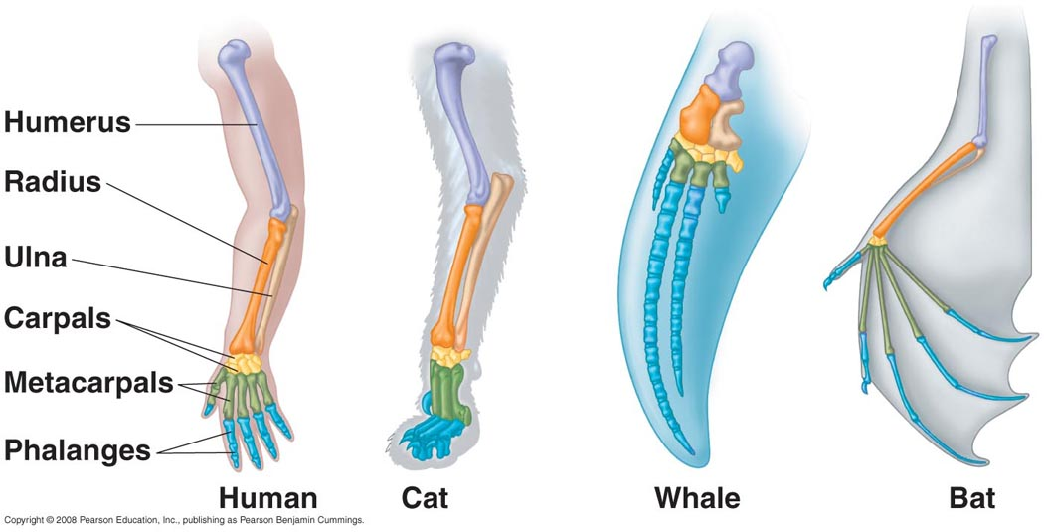
Anatomy
Comparing body parts of different species can provide strong evidence of evolution. Darwin noticed that different organisms have similar body parts, but have different functions.
Homologous structures are features that are similar in structure, but appear in different organisms and may have different functions. E.g. front limbs in humans/cats/whales/bats

Slide 22
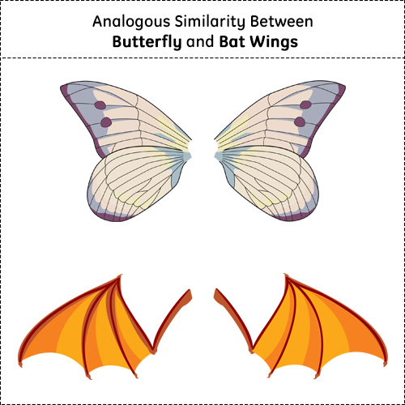
Anatomy
Analogous structures are structures that perform a similar function, but are not similar in origin. E.g. birds/butterflies
Note that, just because two organisms share similar structures does NOT mean they are closely related. Homologous structures show common ancestry, but analogous structures do not.

Slide 23
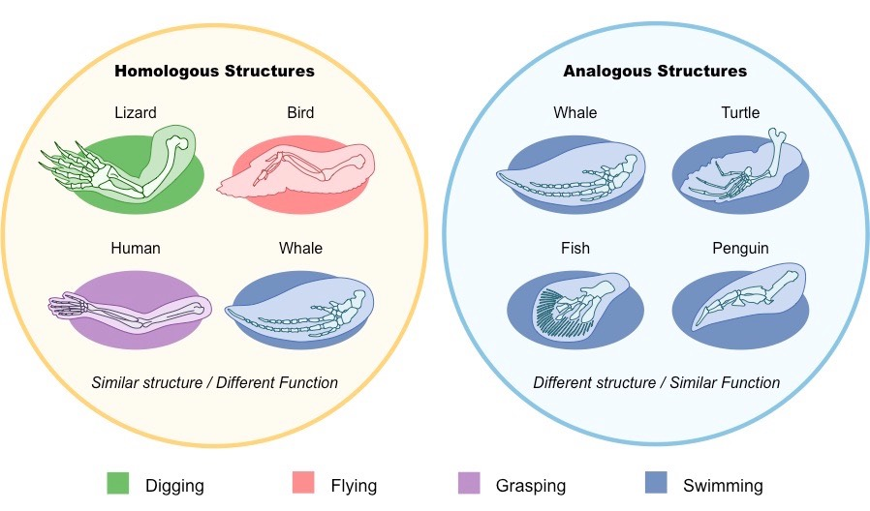

Slide 24
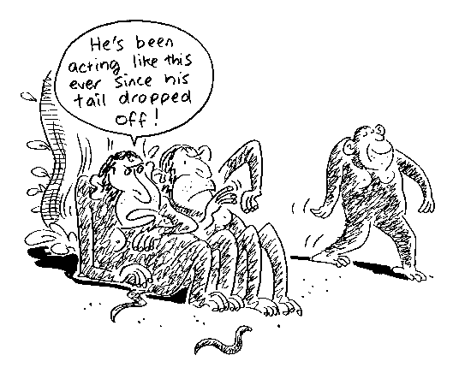
Structural Patterns Providing Clues
Vestigial structures are remnants of organs or structures that had a function in an early ancestor.
E.g. snakes and whales have tiny pelvic bones, even though neither organisms walk!

Slide 25
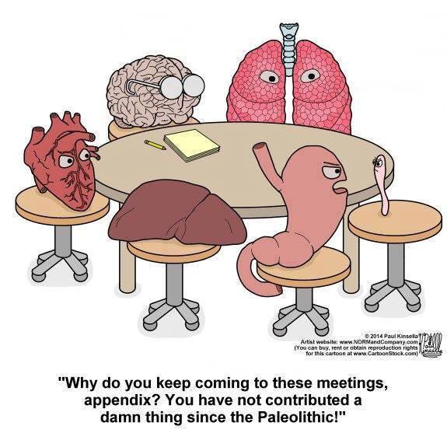
Structural Patterns Providing Clues
In humans, the appendix is considered a vestigial structure. It’s believed that the appendix is a remnant of an organ that helped digest certain plants by human ancestors.

Slide 26
10.3 Theory of Natural Selection
After this section you will be able to……
Compare and contrast artificial and natural selection
Explain how evolution can occur
Describe what adaptations are

Slide 27
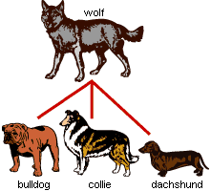
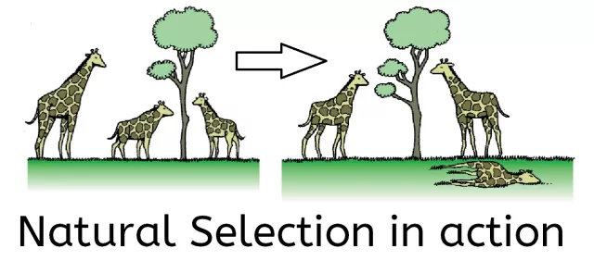
Key Insights
Artificial Selection is when humans select individuals with desired traits in an organism and breed them to produce more individuals with those same traits
Heritability is the ability of a trait to be passed down from one generation to the next.
Natural Selection is a process in which individuals that have inherited beneficial produce more offspring than do other individuals

Slide 28
Struggle for Survival
Thomas Malthus proposed that resources such as food, water, and shelter limited human population growth. This led to Darwin reasoning that a similar struggle happens in nature.
A population is all the individuals of a species that live in an area and noticed individuals in those populations would match the environment they lived in. Darwin proposed that it took many generations to show these adaptations in a process called “descent with modification.”

Slide 29
Natural Selection
Another scientist, Alfred Wallace, independently developed an explanation of how evolution occurs, which was very similar to Darwin’s. In the 1850’s the ideas of both scientists were presented to the scientific community.
Variation is when individuals of a species differ due to genetic variation
Overproduction is when organisms have more offspring than can survive resulting in competition
Adaptation is when some individuals have certain variations that allow them to survive better in their environment
Descent with modification is when beneficial adaptations are produced in more of the next generation with the same environmental conditions
Fitness is a measure of the ability to survive and reproduce.

Slide 30
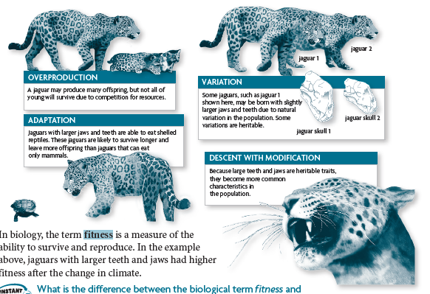

Slide 31
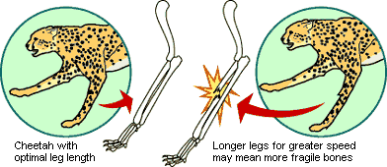
Adaptations as a compromise

